Slide 1
Classroom slides for Faculty members, TAs and TFs
Health and wellness is essential to our students’ academic and personal success. The university remains committed to strengthening the supportive aspects of our living and learning environments.
The following slides have been developed by HCDS staff and are designed to promote awareness of healthy behaviors and provide information about on-campus resources.
Instructors are encouraged to rotate these slides regularly on the front-of-room screen at the beginning of each class, throughout the academic year. This will provide students with an opportunity to read the slide as they wait. Speaking notes are included on the “notes” section of each slide, as well as the months when you may wish to promote each slide.
If you have any questions about the slides, or if you are ever concerned about a student, please contact Counselling Services at ext. 78264 and ask to speak to a counsellor. In addition, we currently have outreach counsellors in the Faculties of Education, Engineering and Applied Science, as well as the School of Graduate Studies and Queen’s School of Business. Faculty members and TAs in those faculties/schools are welcome to contact the outreach counsellor directly for advice. You may also refer to the “green folder” resource that was developed to help identify and respond to students in distress.

Slide 2


How do I stay healthy?
Be active at least 150 minutes a week
Sleep 7-9 hours a night
Access academic help at SASS in Stauffer
Get involved in activities you like to do
Laugh!
Drop by:
PSC
or
HCDS
Eat fruits and veggies every day
Talk to someone if you are feeling overwhelmed
Notes:
Suggested timeline for using this slide: September and January
This slide has been developed by Health, Counselling and Disability Services here at Queen’s to remind you how to stay healthy and take care of yourselves.
Get into healthy habits early in the term!
Sleeping, eating well, exercising, talking about your worries and even laughing can help you manage stress.
If you have any questions or want more information, google Queen’s and “health promotion”.

Slide 3
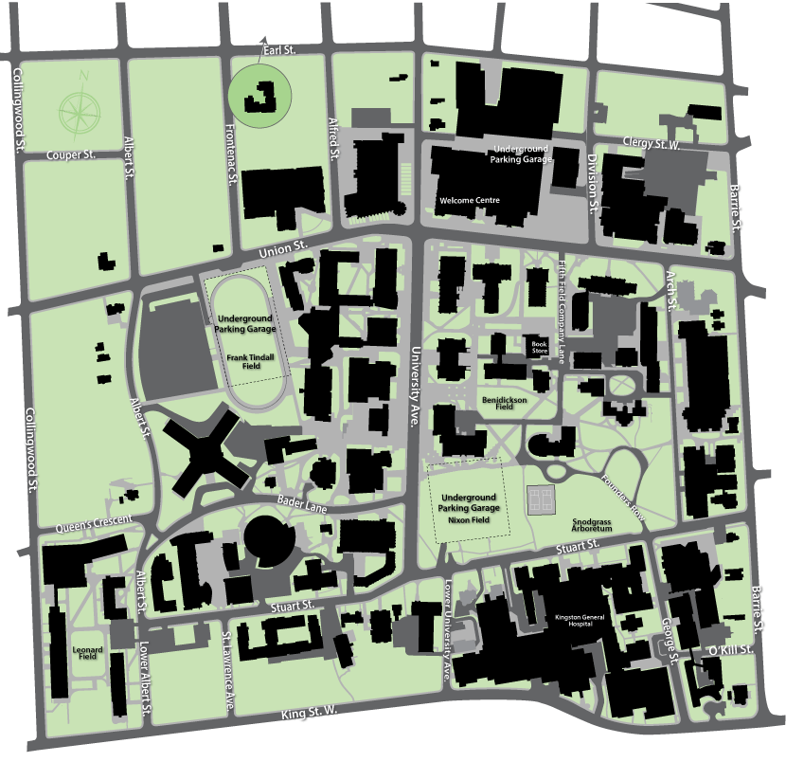
Where to go if you need help
Student Academic Success Services – Stauffer Library
AMS Peer Support Centre –
John Deutsch
University Centre
Career Services –
Gordon Hall
Health, Counselling and Disability Services – LaSalle Building
Notes:
Suggested timeline for using this slide: October and February
This slide has been developed by Health, Counselling and Disability Services to remind you all of some of the on-campus supports that you should check in with if you need some support, whether it’s academic help, career related or personal.
Don’t hesitate to reach out if you need to.

Slide 4
They stop hanging out with friends and doing things you know they like
They are having trouble making decisions or concentrating
They are sleeping way too much or too little
Does your friend need help?
They express feeling hopeless, helpless, sad, and/or anxious
Their weight changes dramatically (gain or loss)
They stop going to class or handing in assignments
Approach, Listen, Support, Refer them to HCDS
Notes:
Suggested timeline for using this slide: November and March
This is a particularly stressful time of year.
This slide has been developed by Health, Counselling and Disability Services to help make sure you that you all know what to do if you notice that a friend may be in trouble or if you are experiencing issues relating to stress.
HCDS is available to support you and your peers. Don’t hesitate to ask for help or refer a friend.

